Slide 1
Data Analysis and Visualization on Stroke Data
Presented by:
Anish Bhurtyal
Bijay Adhikari
Sadikshya Shrestha
Saurav Dahal

Slide 2

What is a stroke?
A stroke is a medical emergency. A stroke can occur when blood flow to the brain is blocked or there is sudden bleeding in the brain.A stroke can cause lasting brain damage, long-term disability, or even death.

Slide 3


Stroke Facts
In 2021, 1 in 6 deaths from cardiovascular disease was due to stroke.
Every year, more than 795,000 people in the United States have a stroke. About 610,000 of these are first or new strokes.
High blood pressure, high cholesterol, smoking, obesity, and diabetes are leading causes of stroke. 1 in 3 U.S. adults has at least one of these conditions or habits.
Source: Centers for Disease Control and Prevention
Link: https://www.cdc.gov/stroke/facts.htm

Slide 4
Project Objective and Data Source
Our project aims to use Data Analysis and Visualization to predict stroke occurrences by utilizing the "Stroke Prediction Dataset" from Kaggle, compiled by Fedesoriano. We want to identify potential stroke events based on various health indicators and demographic factors and lifestyle information contained within the dataset. This approach not only enhances our understanding of the risk factors associated with strokes but also aids in proactive healthcare planning and management.
Data Source Link: https://www.kaggle.com/datasets/fedesoriano/stroke-prediction-dataset

Slide 5
Data Source and Features
5110 Observations
12 Variables
Data Source
https://gist.github.com/aishwarya8615/d2107f828d3f904839cbcb7eaa85bd04

Slide 6
Data Description
Age
Numerical variable indicating the age of the patients.
Hypertension
Binary variable indicating if the patient has hypertension
Heart Disease
Binary variable indicating if the patient has any heart disease.
Marital Status
Categorical variable indicating marital status.
Work Type
Categorical variable indicating the type of occupation.
Residence Type
Categorical variable differentiating between rural and urban residence.
Continuous variable showing the average glucose level in blood.
Average Glucose Level
BMI
Continuous variable indicating the Body Mass Index.
Smoking Status
Categorical variable indicating the smoking status.
Stroke
Binary target variable indicating if the patient had a stroke.
Gender
Binary variable indicating the gender of the patient..

Slide 7
Research Questions
Research Question 1: What is the distribution of the predictive physical health factors and demographic factors such as hypertension, health stroke, BMI, and glucose levels etc among individuals in the dataset?
Research Question 2: How do different factors interact to influence the risk of stroke in a population?
Research Question 3: Does higher mean age, BMI, and glucose level correlate with an increased risk of stroke compared to individuals with lower values in these parameters?
Research Question 4: Based on the previous visual and statistical analyses, how do the different factors affect the chance of having a stroke, and how can these be visually represented to aid understanding?

Slide 8
Research Question 1
What is the distribution of the physical health and demographic predictive factors such as hypertension, heart disease, BMI, and average glucose levels etc among individuals in the dataset?

Slide 9
HEALTH RELATED FACTORS

Slide 10
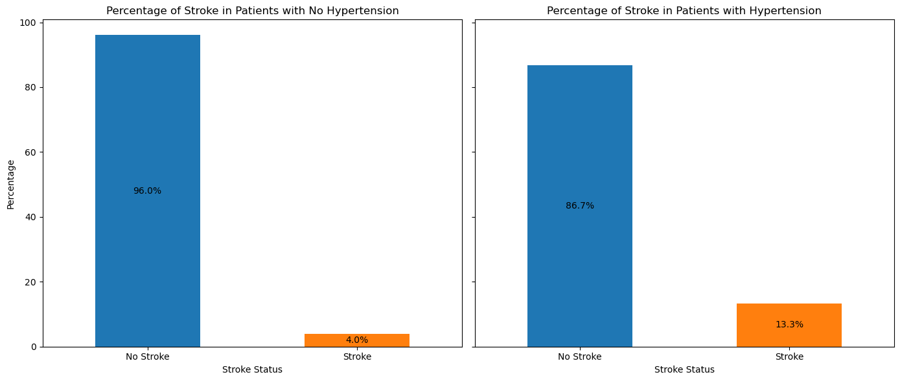
HYPERTENSION
Notes:
A significant number of individuals without hypertension have not experienced a stroke, as depicted by the large orange bar. This suggests a lower incidence of stroke among those without hypertension.
Conversely, among those with hypertension, a smaller count has experienced a stroke (small blue bar on the right), but the count is visibly higher compared to those without hypertension. This may imply a potential correlation between hypertension and increased stroke risk.

Slide 11
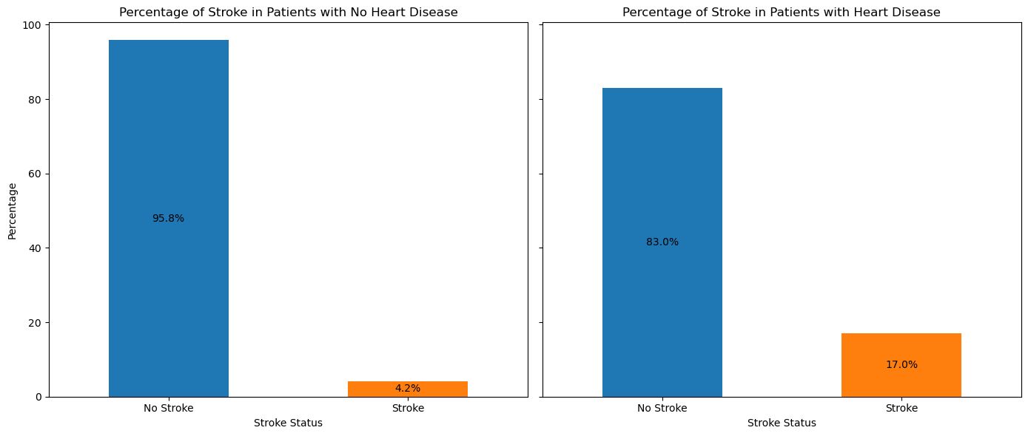
HEART DISEASE

Slide 12
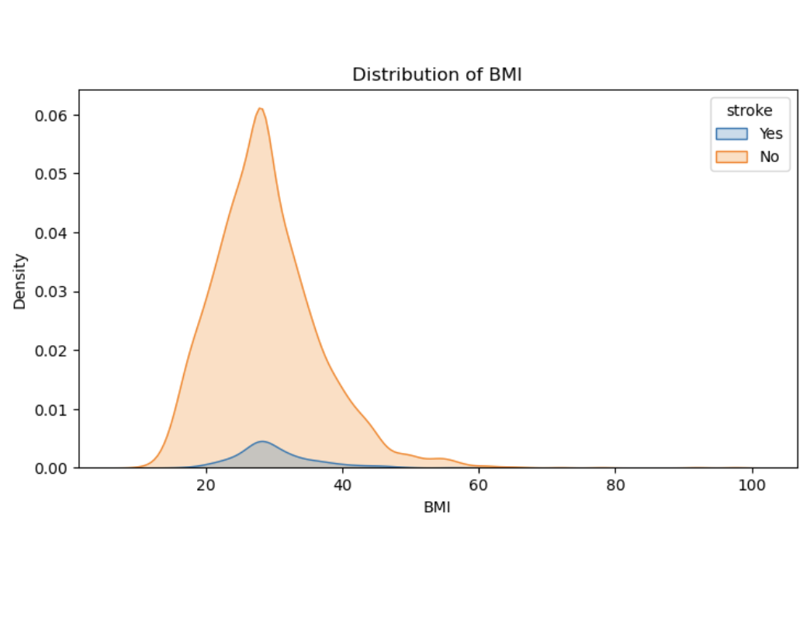
BMI
Notes:
This graph is a density plot illustrating the distribution of Body Mass Index (BMI) values for individuals grouped by their stroke status.
Right skewed, mean>median

Slide 13
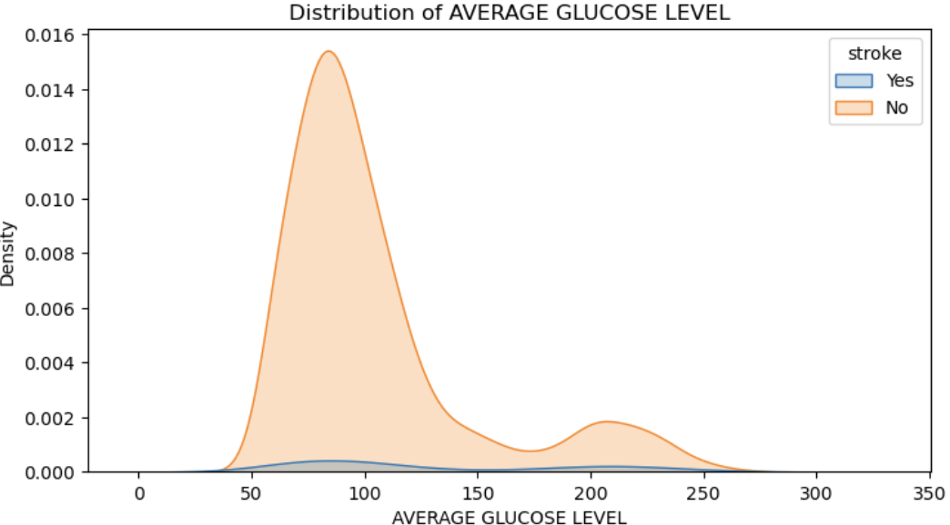
AVERAGE GLUCOSE LEVEL
Notes:
Right skewed

Slide 14
DEMOGRAPHIC VARIABLES

Slide 15
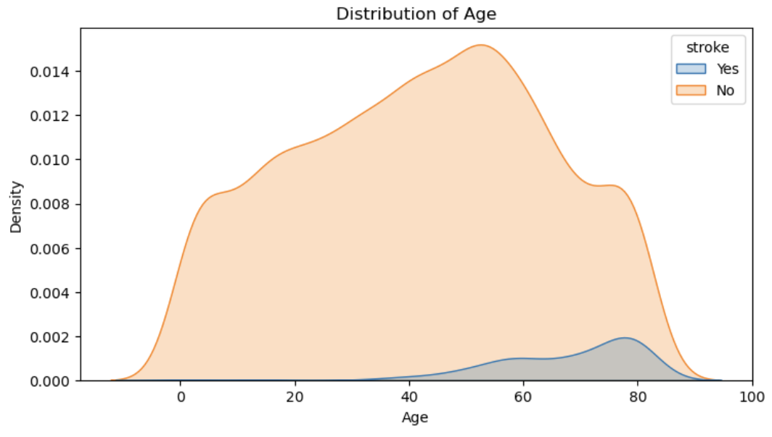
AGE

Slide 16
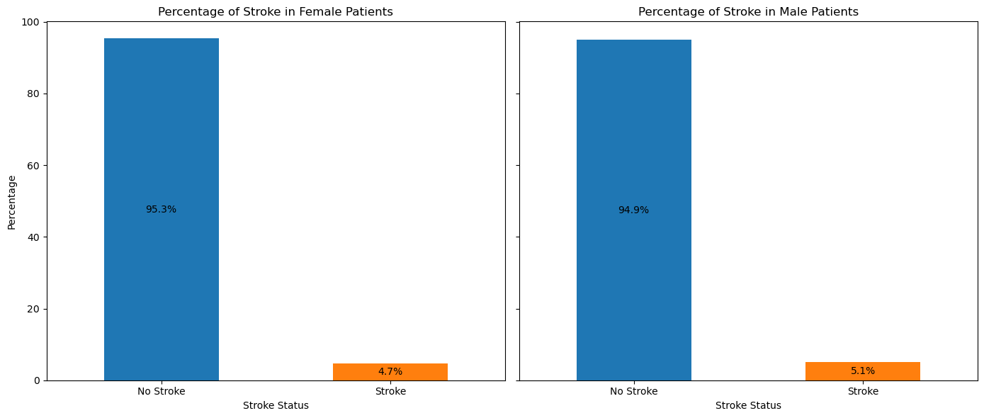
GENDER

Slide 17
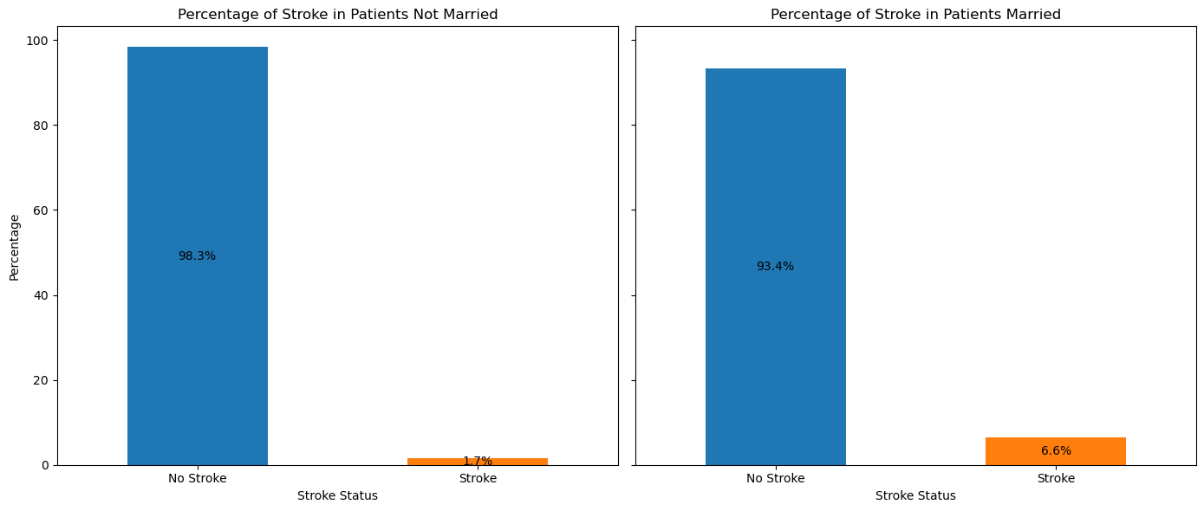
MARITAL STATUS

Slide 18
Research Question 2
How do different factors interact to influence the risk of stroke in a population?
Notes:
We've leveraged scatter plots, to explore relationships between key variables, that includes age, average glucose levels, and BMI—factors known to be significant in stroke risk assessment.

Slide 19
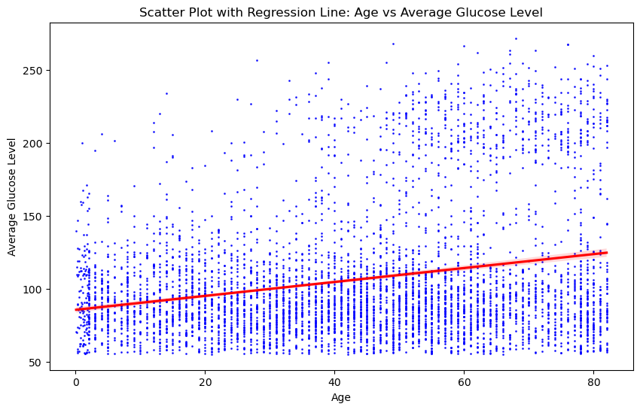
Age vs Average Glucose Level
These factors are critically linked to metabolic health, which in turn influences stroke risk.
The plot reveals a positive trend, suggesting that as people age, their average glucose levels tend to rise.

Slide 20
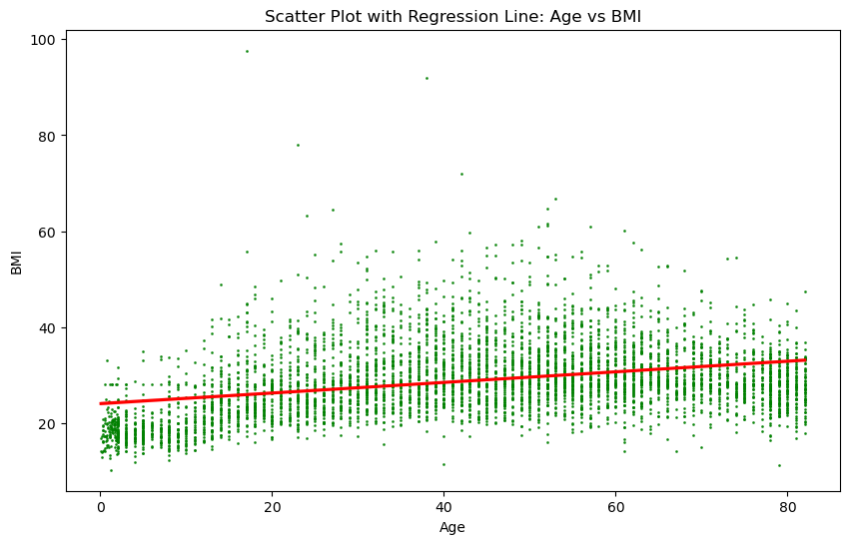
Age vs BMI
Both age and obesity are known contributors to various cardiovascular diseases, including stroke.
This plot shows a positive trend, suggesting an increase in BMI as age increases.

Slide 21
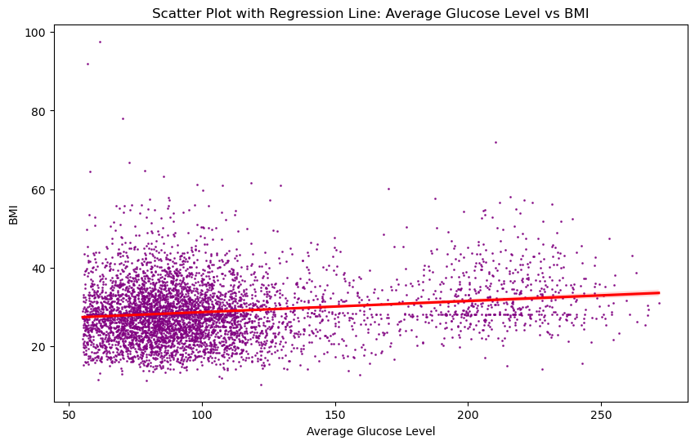
Avg Glucose Level vs BMI
Both are key indicators of metabolic syndrome, which is a cluster of conditions that increases the risk of heart disease and other health problems.
The regression line is relatively flat, indicating a weak correlation between BMI and glucose levels in this dataset.
Notes:
Let's pivot from our individual analysis of age, glucose levels, and BMI to a broader view with our correlation matrix. This overview will help us see how all the factors we're studying interconnect, not just one-on-one but within the entire dataset.

Slide 22
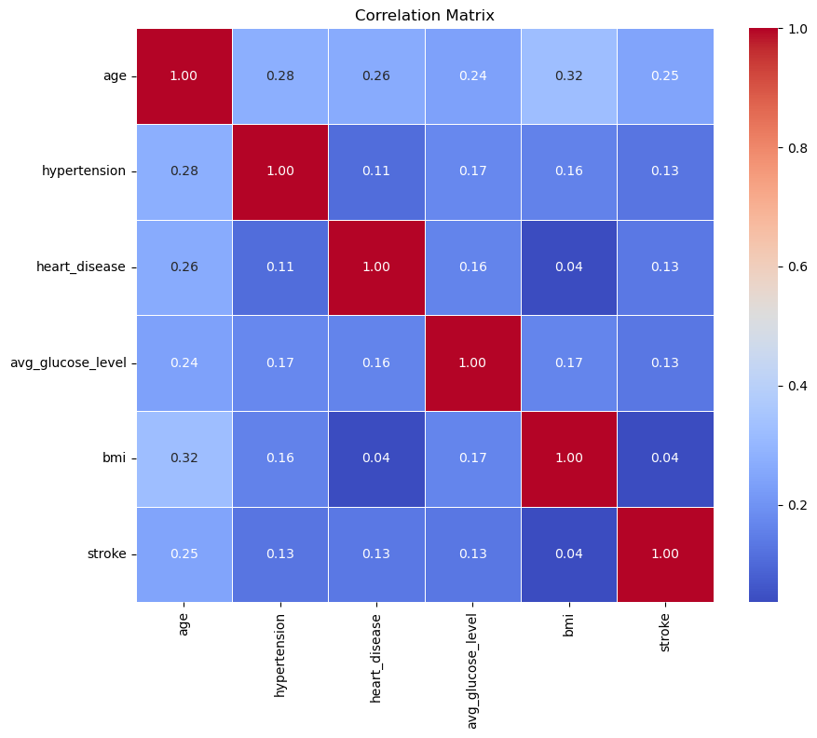
Correlation Matrix
No strong correlation between our features.
The highest correlation can be observed between body mass index(bmi) and age.
The weakest correlation can be observed between stroke and bmi (questionable).

Slide 23
Chi-Square Test for Stroke Risk Factors
Ho: There is no association between the categorical factor and the occurrence of stroke
Lifestyle and health conditions such as hypertension, heart disease, marital status, work type, and smoking significantly impact the likelihood of stroke.
Conversely, where a person lives – urban or rural – does not significantly influence stroke risk within this study group.
Predictor | Chi-square | P-value
Hypertension | 81.57 | 0.0000
Heart Disease | 90.23 | 0.0000
Ever Married | 58.87 | 0.0000
Work Type | 49.16 | 0.0000
Residence Type | 1.07 | 0.2998
Smoking Status | 29.23 | 0.0000
Notes:
A Chi-square test is a hypothesis testing method for checking if observed frequencies in one or more categories match expected frequencies. It is used to analyze categorical data and assess the independence or association between variables.

Slide 24
EFFECT OF LIFESTYLE ON STROKE

Slide 25
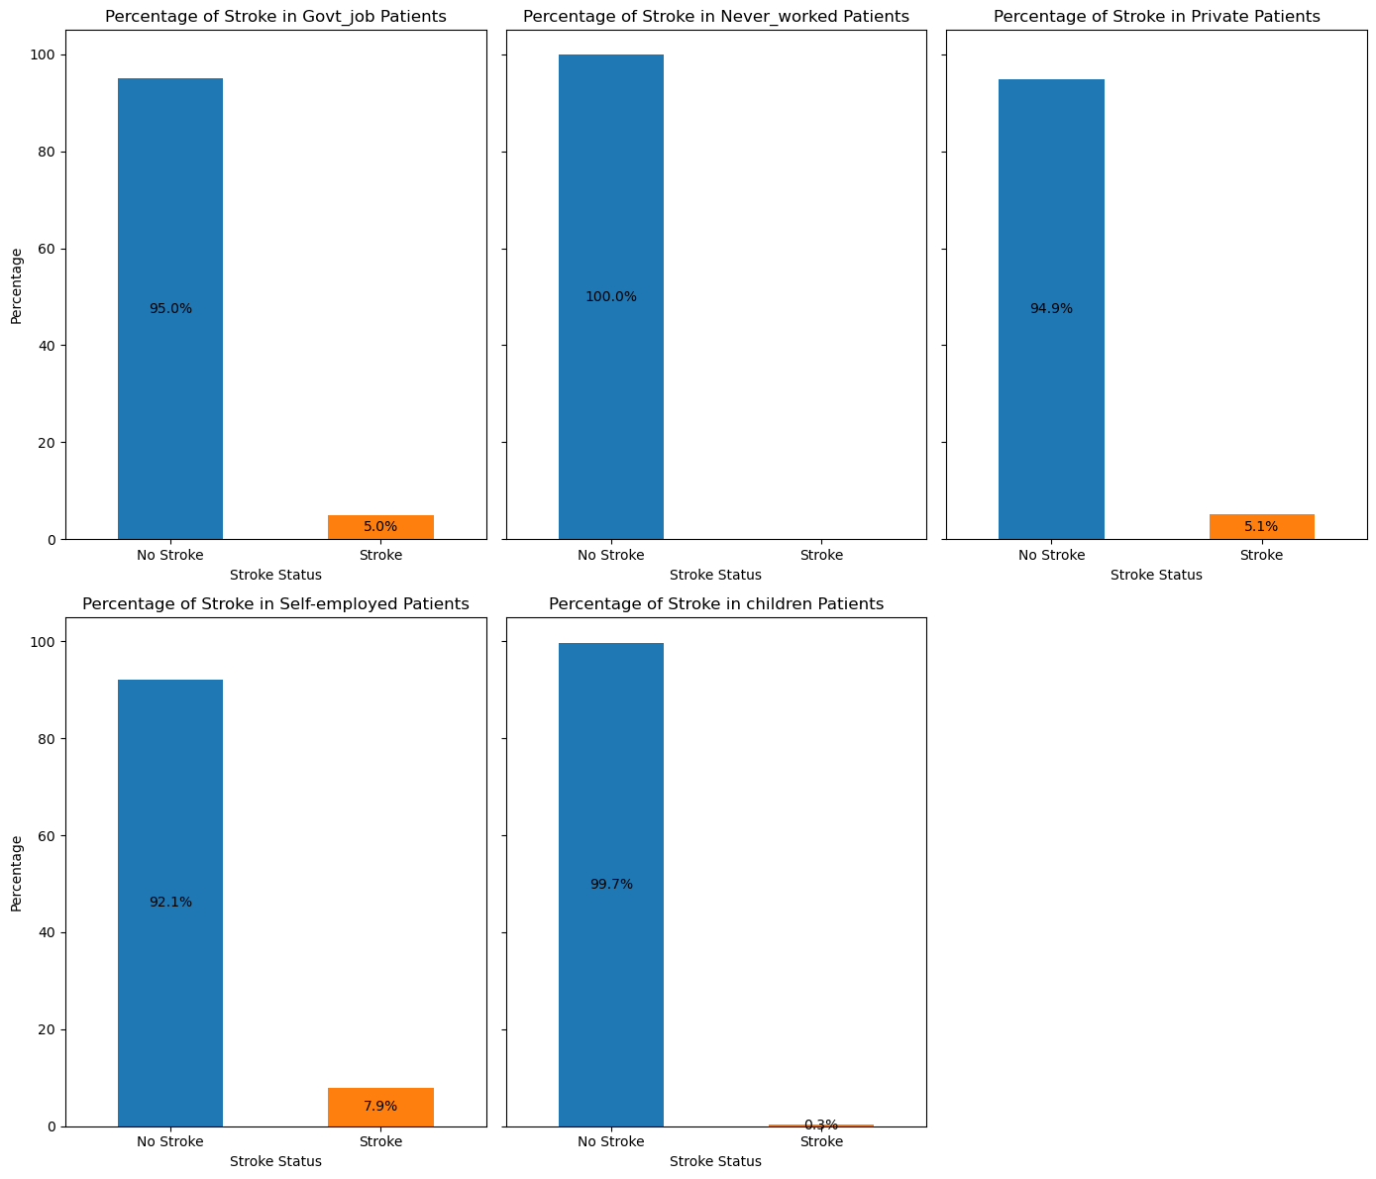
WORK TYPE

Slide 26
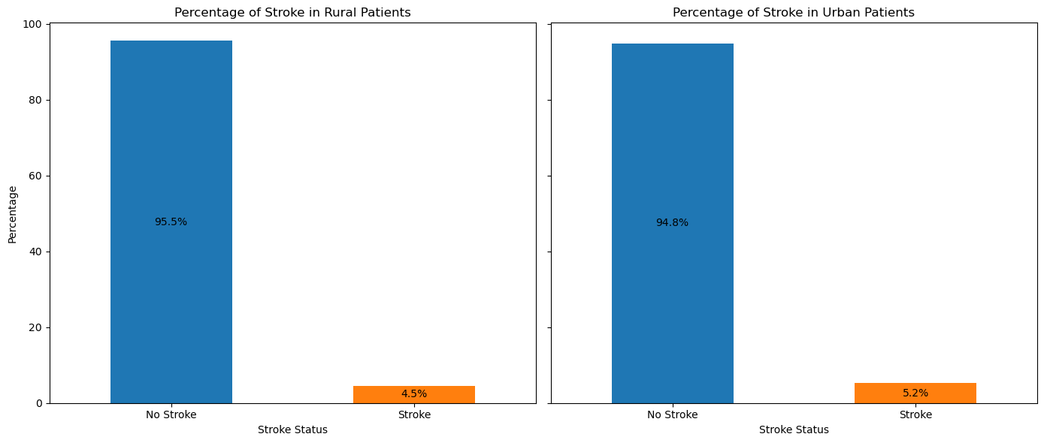
RESIDENCE TYPE

Slide 27
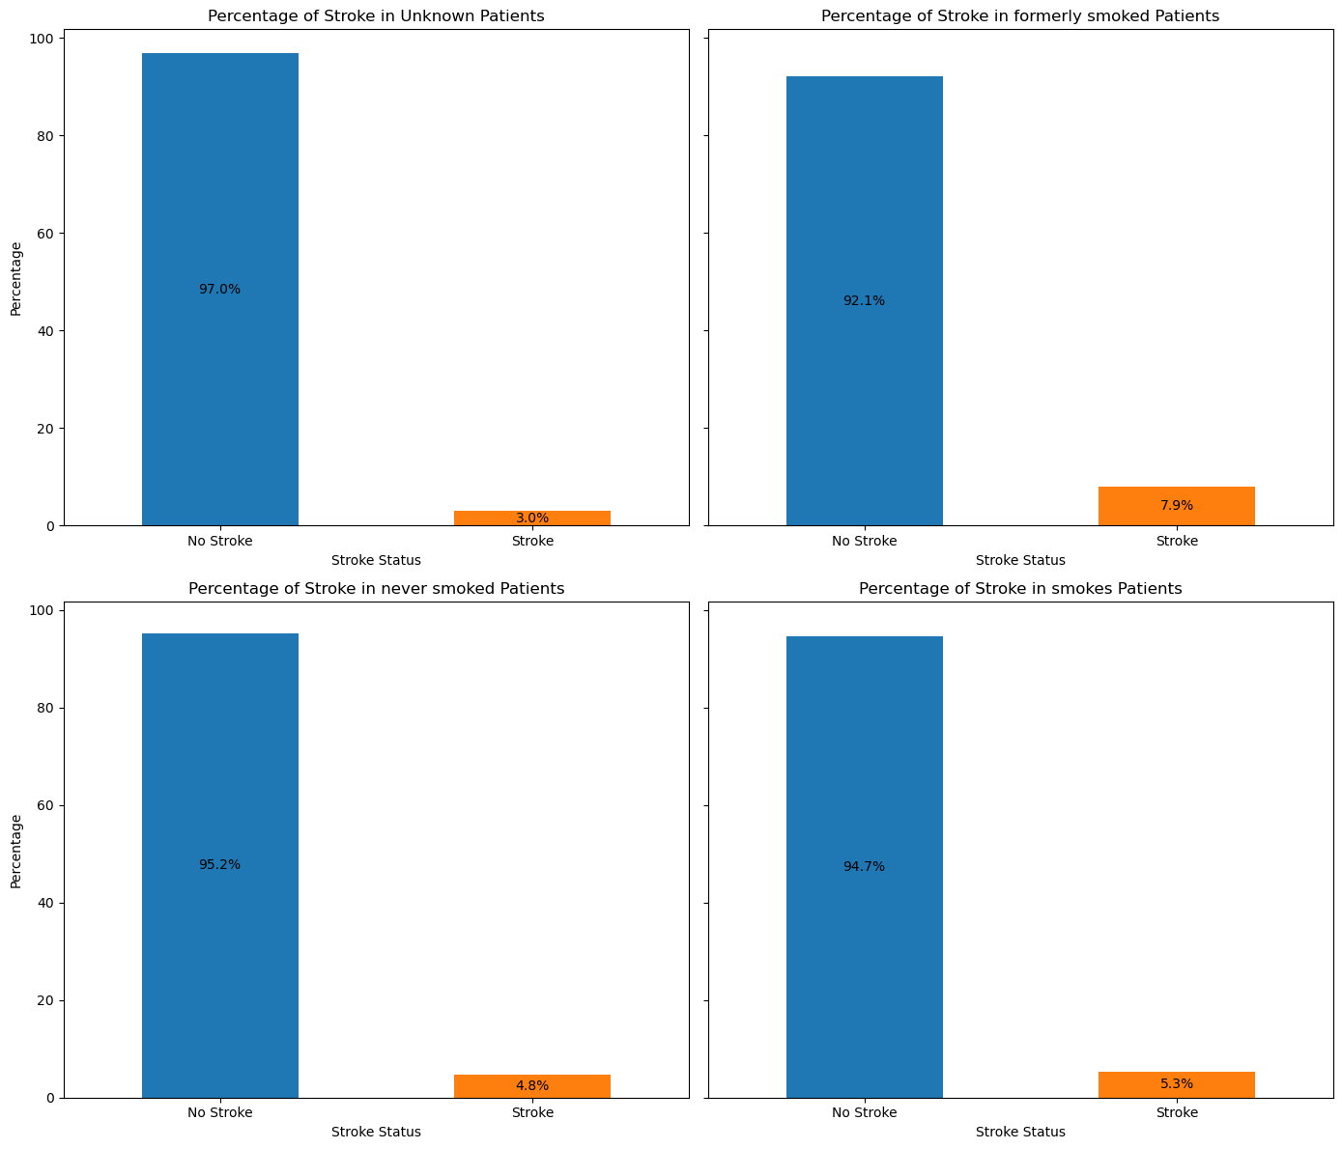
SMOKING STATUS

Slide 28
Research Question 3
Does higher mean age, BMI, and glucose level correlate with an increased risk of stroke compared to individuals with lower values in these parameters?

Slide 29
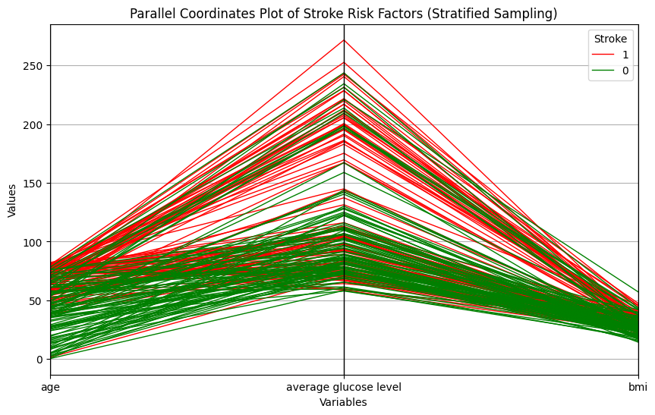
What factors associate with stroke risk factors?
Age roughly ranges from 0 to 80, glucose level from 55 to 270, bmi from 10 to 80

Slide 30
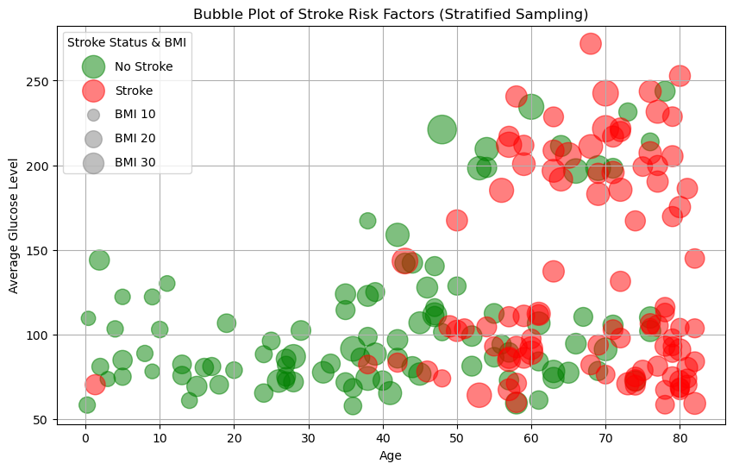
What factors capture relationships between stroke risk factors?

Slide 31
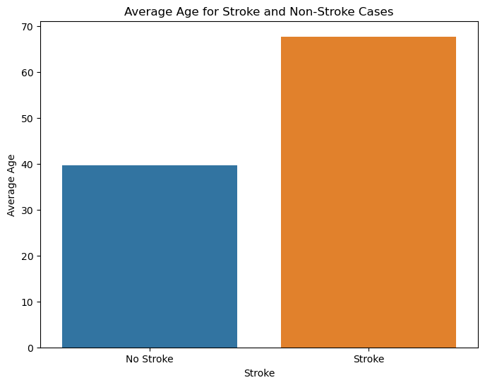
Hypothesis Test for Age Predictor
We performed one-sided t-test for 'age' with the alternative hypothesis that mean of 'stroke' group is greater
Ho: The mean age of individuals in the stroke group is less than or equal to the mean age of individuals in the non-stroke group.
Ha: The mean age of individuals in the stroke group is greater than the mean age of individuals in the non-stroke group
T-stat
p-value
18.0776
3.71* 10^-71
The mean age, is significantly higher for individuals who have experienced a stroke compared to those who have not.

Slide 32
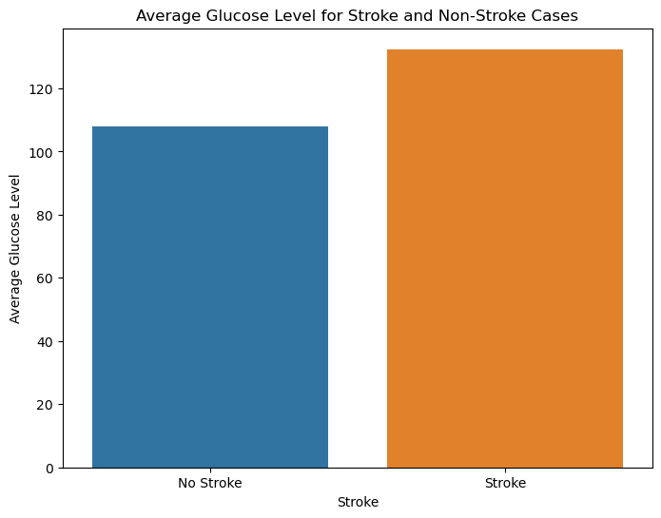
Hypothesis Test for Glucose Level Predictor
We performed one-sided t-test for glucose level with the alternative hypothesis that mean of 'stroke' group is greater
Ho: The mean glucose level of individuals in the stroke group is less than or equal to the non-stroke group.
Ha: The mean glucose level of individuals in the stroke group is greater that of individuals in the non-stroke group
T-stat
p-value
9.515
1.35* 10^-21
The mean glucose level, is significantly higher for individuals who have experienced a stroke compared to those who have not.

Slide 33
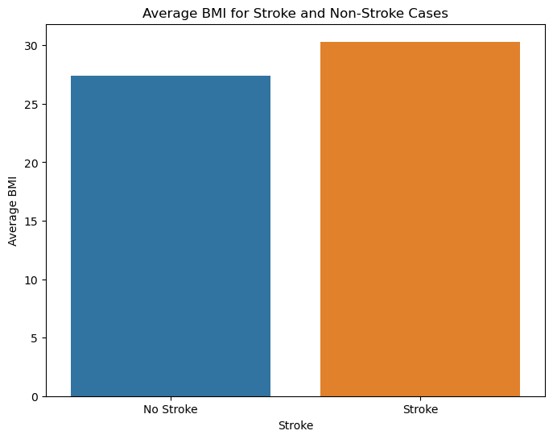
Hypothesis Test for BMI Predictor
We performed one-sided t-test for BMI with the alternative hypothesis that mean of 'stroke' group is greater
Ho: The mean BMI of individuals in the stroke group is less than or equal to the non-stroke group.
Ha: The mean BMI of individuals in the stroke group is greater than the mean age of individuals in the non-stroke group
T-stat
p-value
2.579
0.0049
The mean BMI, is significantly higher for individuals who have experienced a stroke compared to those who have not.

Slide 34
Research Question 4
Based on the previous visual and statistical analyses, how do the different factors affect the chance of having a stroke, and how can these be visually represented to aid understanding?

Slide 35
Logistic Regression
Logistic regression is a statistical method used for binary classification. Logistic regression is particularly useful because it provides the odds ratio for each independent variable, helping to understand how significant an independent variable is in predicting the outcome.

Slide 36
Logistic Regression Result
Predictors | Coefficient
Intercept | -4.1493
Age | 1.7234
Average Glucose Level | 0.1177
BMI | 0.0153
Hypertension | 0.0144
Heart Disease | 0.1680
Gender (Male) | 0.0123

Slide 37
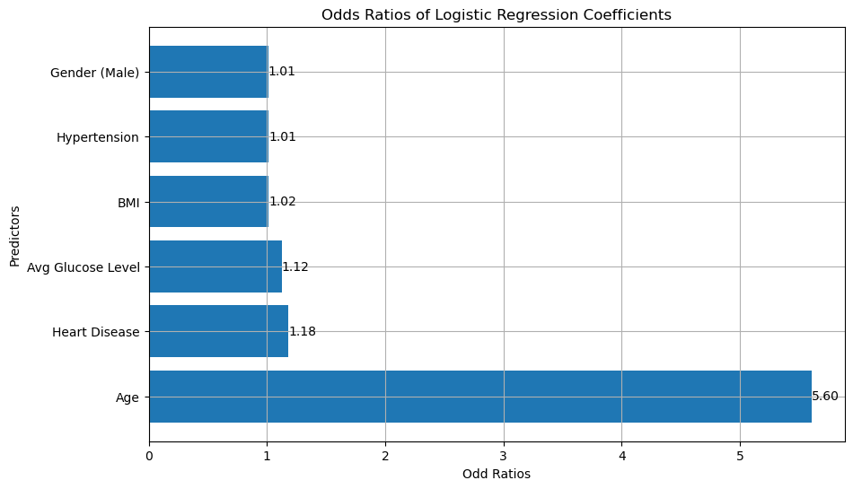
Result Interpretation Using Barplot

Slide 38
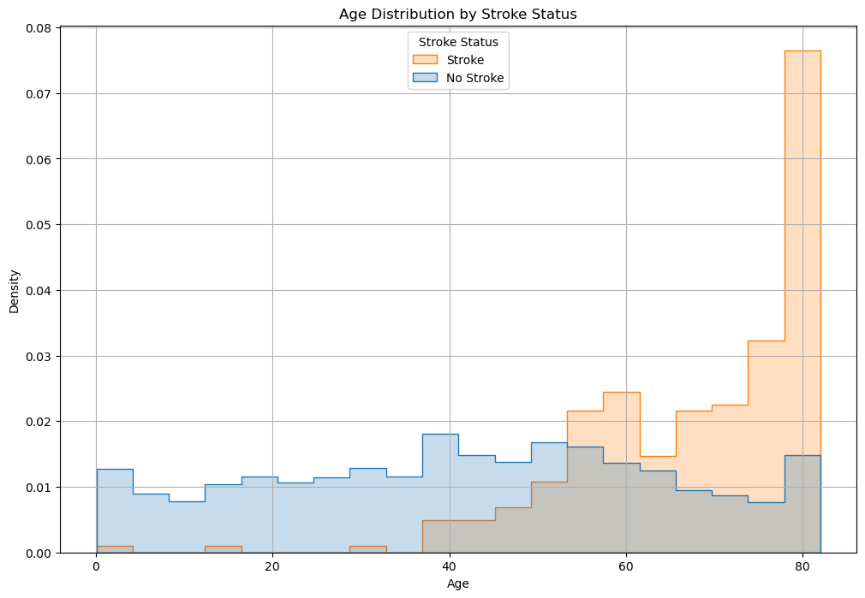
Age Distribution

Slide 39
Stroke by Heart Disease

Slide 40
Stroke by Hypertension

Slide 41
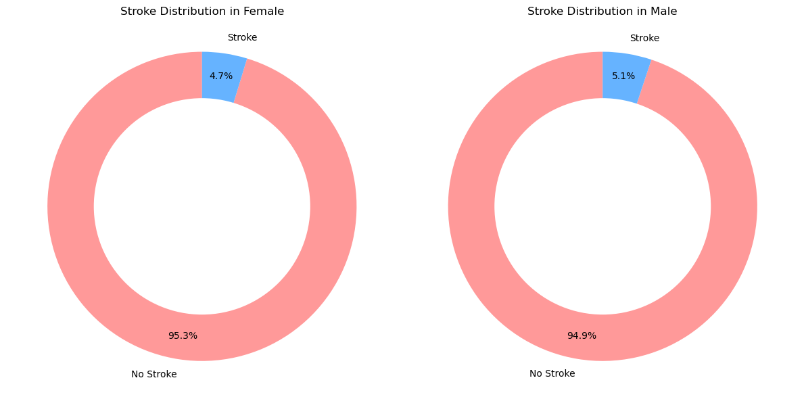
Stroke by Gender

Slide 42
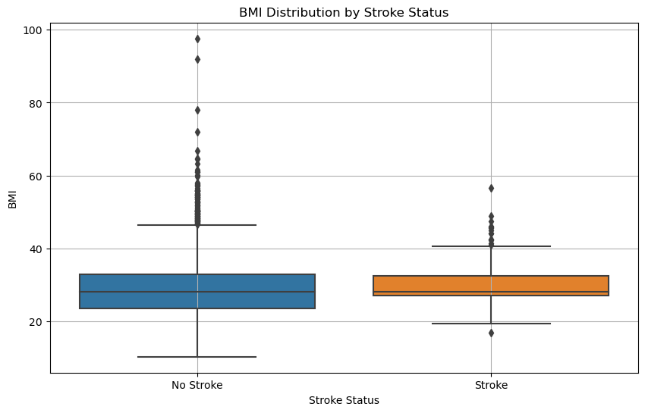
Boxplot for BMI By Stroke

Slide 43
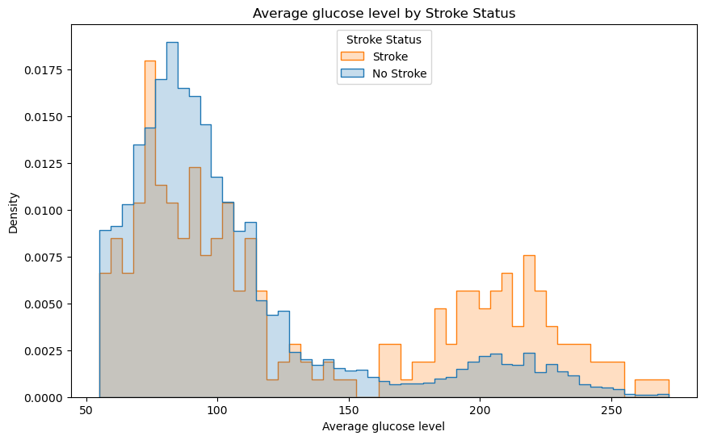
Average glucose level by Stroke

Slide 44

Recap
Conclusion
In our project, we performed Data Analysis and Visualization on Strokes Dataset
We explored relationships between variables using appropriate plots.
We conducted statistical tests to determine if differences between patients with stroke.
We performed Logistic Regression and analysed the coefficients of sig. predictors
We interpreted coefficients and odds ratios to identify significant predictors with visualizations as well.
Age and BMI Stroke Risk
Older age groups are significantly more susceptible to strokes.
Higher BMI had an increased risk of stroke
Glucose Level Impact
High and low extremes in glucose levels correlate with increased stroke risk.
Gender and Stroke Incidence
Males have a higher stroke incidence compared to females.
Heart Disease and Hypertension Link
Existing heart disease and hypertension greatly increases stroke risk.
Predictor Significance
Notable statistical differences in key predictors between stroke and non-stroke individuals.

